Slide 1
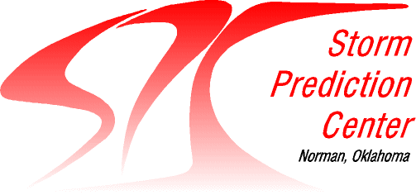
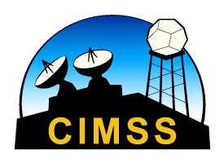
NUCAPS Soundings in AWIPS
Scott Lindstrom UW CIMSS
Thanks as well to…
Chris Barnet STC Rebekah Esmaili STC
Emily Berndt NASA SPoRT Tony Reale NOAA / SMCD Dan Nietfeld NOAA / GSD
Updated: February 2022
Notes:
This is a training on NUCAPS Soundings that are available in AWIPS.
This training will explain how NUCAPS soundings are created, how to find them in AWIPS, how to use them and how to modify them.

Slide 2
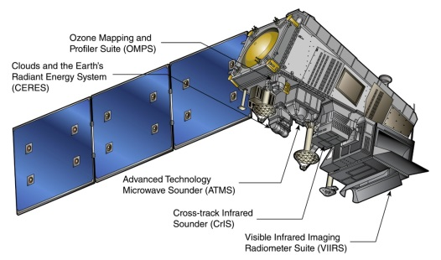
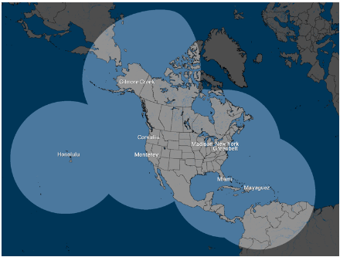
NUCAPS
NOAA-Unique Combined Atmospheric Processing System
What is Combined?
NOAA-20
CrIS: Cross-track Infrared Sounder (1305 channels)
ATMS: Advanced Technology Microwave Sounder (22 channels)
Overpass Times:
NOAA-20
East Coast: 05z/17z
Plains 06z/18z
West Coast 09z/21z
0130/1330 Local Time
Satellite
Downlink
NSOF
(NDE)
NWS
Gateway
Local Antenna Downlink
CONUS Data Flow
~60 minutes
SBN
Antenna Data Flow
CSPP < 30 minutes
WFO
WFO
This is faster with N20 than with SNPP
Notes:
NUCAPS is the NOAA Unique CrIS ATMS Combined Atmospheric Processing System, combining information from CriS (an infrared sounder) and ATMS (a microwave sounder) on Suomi/NPP, or IASI and AMSU/MHS on MetopA and Metop/B. The Equatorial crossing times for the different polar orbiters are shown. Data appears in AWIPS after it is downlinked at Svalbard and then proceeds through computers that process it – and that process takes about 60 minutes. If you have access to a direct broadcast antenna, as shown in that small image, you can have NUCAPS soundings in AWIPS more quickly – about 30 minutes.

Slide 3
How are Vertical Profiles Produced
Regression uses static coefficients (derived from ECMWF output for four focus days [2014: 6/18, 9/15, 12/20; 2015: 3/21]) to create a first guess/cloud-clearing field.
Regression uses all Sounder and Microwave channels
Retrieval minimizes Observation-Calculation value
First Guess: NCEP-based Climatology + GFS Surface Pressure
If this doesn’t converge to a solution, sounding is still produced, but flagged
Retrieval uses a subset of channels
Shape-preserving; adjusts regression to the solution
Infrared retrieval most likely to fail in cloudy/rainy regions
Microwave-only retrieval fails in regions of precipitation
Final Sounding is computed on 100 levels that are standard for a Radiative Transfer Model
More levels than warranted by Sounder resolution
You see these 100 levels in AWIPS 2
Notes:
A physical retrieval is used to produce the sounding, minimizing the difference between observations and calculations. If the environment really deviates from normal (the first guess is climatology), the retrieval has to do a lot of work to converge to a solution. If that convergence to a solution doesn't happen, the sounding is still produced, but flagged.
What is OBS-CALC? The OBS Vector is a cloud-cleared radiance spectrum (using the subset of Sounder radiances). The CALC vector is from a radiative transfer model that uses the regression solution – trained with the ECMWF – and climatology.
The final output is mapped to 100 levels that are standard for a radiative transfer model. You'll notice the 100 levels in AWIPS are always the same pressure surfaces. It's really more levels than are resolved.

Slide 4
Cloud Clearing
Clouds can cause problems with Satellite-based retrievals
Biggest problem: Uniform clouds!
Each NUCAPS Footprint contains 9 CrIS Fields-of-view. If there is spatial variability to the clouds among the 9 FOVs, NUCAPS can nevertheless produce a useful product
If there are uniform clouds across the 50-km scene/9 FOVs, it’s more likely to be rejected, even if there aren’t a lot of clouds!
Cloud Clearing tests use Regression output that is based on all Infrared and Microwave data
If Cloud-Clearing fails: Yellow Dot in AWIPS
Notes:
Cloud-clearing is an important part of the NUCAPS algorithm. From the algorithm perspective, uniform clouds are the biggest problem. Each NUCAPS footprint contains 9 CrIS (for SuomiNPP) or IASI (for MetOp) Fields-of-view; if there is spatial variability to the clouds among those 9 Fields-of-view, NUCAPS will nevertheless produce a good product. If there are uniform clouds across the 50-km scene, then it’s more likely to be rejected (even if there aren’t a lot clouds!)

Slide 5
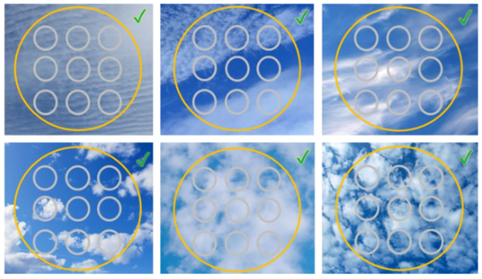
Clear v. Cloudy
Will pass muster as clear enough
Too cloudy! A thin cloud is still a cloud

Slide 6
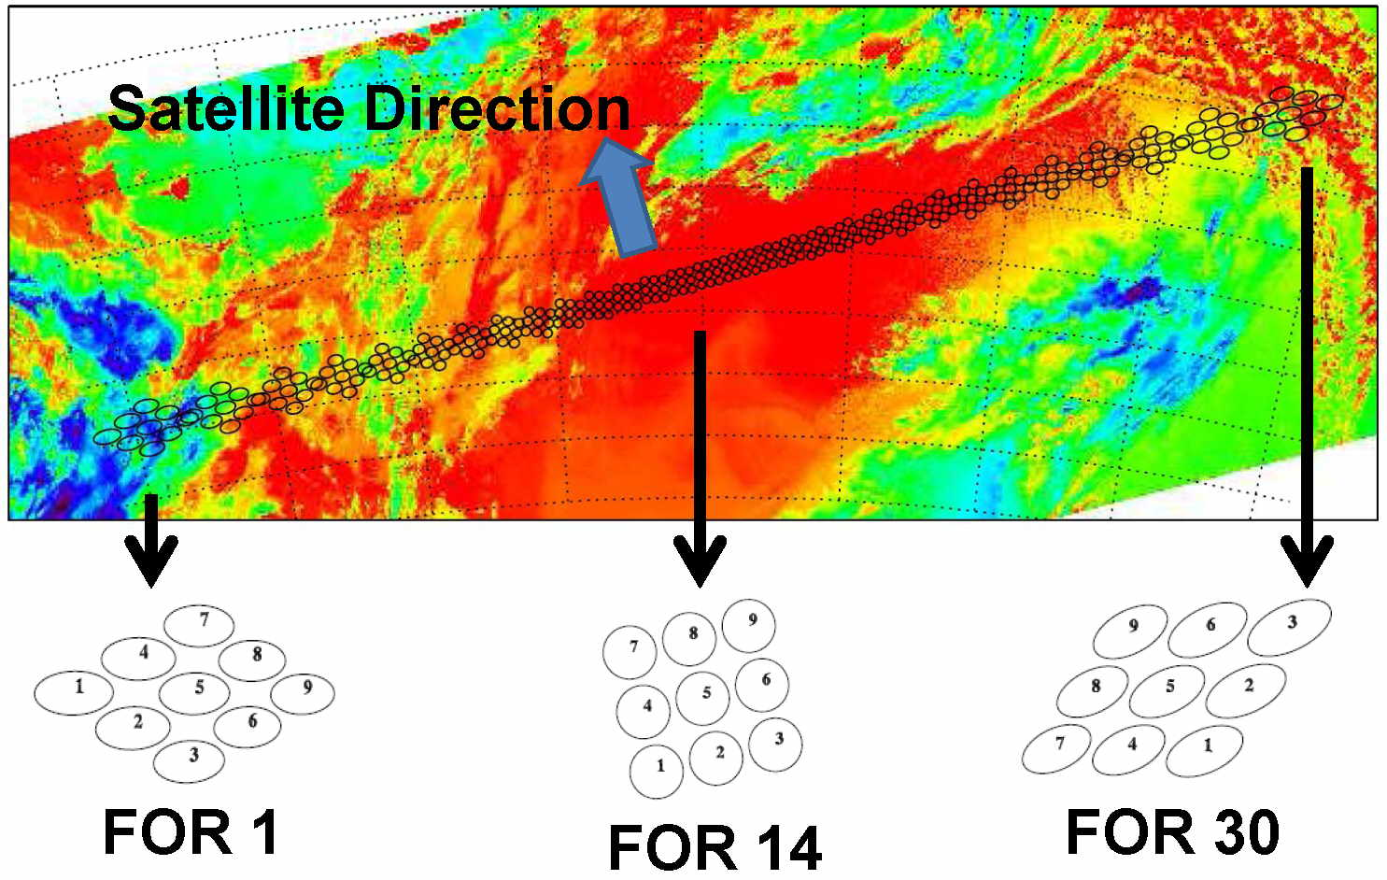
Each of the green dots in the NUCAPS display includes information
from up to 9 Fields of Regard from the CrIS or from IASI. Dot #5 is
the location of the green dot in the NUCAPS AWIPS Display
It takes 8 seconds to scan these 30 Fields of Regard
Scan isn’t quite as wide as a VIIRS swath
Notes:
This shows the 9 Fields of Regard in CrIS for each NUCAPS sounding. At nadir, they're closely spaced, and towards the limb they are more widely spaced. It's not uncommon for sky conditions to vary across the Fields of Regard. (I use Fields of Regards interchangeably with Fields of View)
The Sounder Fields of Regard do not extend to the edge of the swath

Slide 7
How does a retrieval work?
This side uses a 100-layer Radiative Transfer Model (RTM)
A function of climo and sfc pressure
Use Model to compute Radiances
First Guess for Model
Account for radiance bias
Calculate Transmittance
Compare Residuals
Modify Profiles and Skin Temperature
If Residuals are small enough, success!
Too many cycles? Failed to converge
A similar flow-chart is here, part of this
Notes:
This is a general flow chart for a retrieval. The important part is the right hand side. Radiances are computed, and compared to values in the radiative transfer model, and then adjusted and recomputed. This continues until the comparison is small, or until a maximum number of iterations has occurred.

Slide 8
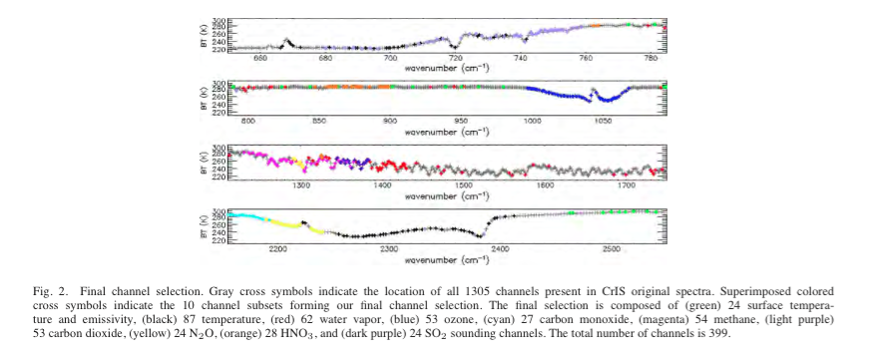
Which of the 1305 channels are used in the retrieval?
399 (out of 1305) CrIS channels are used in the physical retrieval (that is: not all of them!)
24 (window) channels: surface temperature [clear sky!]
87 channels: atmospheric temperature
62 channels: water vapor
Channels chosen most sensitive to one gas and least sensitive to other gases
All ATMS channels (22 of them) are used in NUCAPS for NOAA-20
Notes:
NUCAPS soundings are produced using first a regression and then a physical retrieval. The Regression step uses coefficients trained from cases that used all sounder and microwave data and ECMWF model output on select days in the past. These past data were used to find coefficients forcing the best statistical relationship between the satellite data and the profiles of Temperature and moisture (“Best” being subject to the constraints of the weather on the test days, of course). That set of static coefficients are used with present-day regressions. Regressions with daily data use *all channels*, so they capture more vertical structure than in the final physical retrievals that use a subset of sounder (that is, CrIS or IASI) channels.
The regression is done first with all data to produce temperature and moisture profiles, these data are used to do cloud-clearing – more on that in a minute. Then a physical retrieval is done using a subset of 399 of more than 1300 CrIS channels, as shown on this chart (a different subset is used for IASI on Metop, of course). In the physical retrieval, the algorithm sequentially solves for temperature, moisture, ozone and other gases. The first guess for this is climatology: Think about what that means if you are in a regime that deviates significantly from normal. There are 24 channels (highlighted in green) from which surface temperature is retrieved, 62 (in red) from which water vapor is retrieved, etc. These channels selected are most sensitive to one gas while being less sensitive to other gases. That is, they have high (but not perfect) spectral purity. In contrast to the subset of Sounder channels shown above, All Microwave channels are used in NUCAPS. The ATMS retrieval is the solution if either the cloud clearing fails or if the Physical retrieval fails.

Slide 9
What (and where) is the most useful information in a NUCAPS profile?
Water Vapor, mid-troposphere
Temperature is already pretty well forecast by models, so NUCAPS doesn’t give a lot of additional information
Water vapor distribution is harder to initialize, and therefore harder to simulate in a model
NUCAPS observations tell you where water vapor gradients might sit (and how they might have changed since the last observation)
Strengths:
Gradients
Changes in time
Large swaths of observed data where only model data are available (think: Oceans)
Observations in the US that are in between radiosondes
Vertical resolution is much smoother than radiosondes
A NUCAPS profiles is of a volume of air
Always compare near-surface values to observations

Slide 10
Effective vertical resolution
‘Interfering Parameters’ : gases that reduce precision of NUCAPS temperature or water vapor estimates
Variable
d.o.f. (Degrees Of Freedom) relates to the number of layers that are resolved by NUCAPS data within the troposphere.
NUCAPS profiles are smooth!
Notes:
NUCAPS resolves about 5 vertical levels of water vapor, and about 6-10 layers of temperature in troposphere. Vertical profiles are much smoother than a radiosonde!

Slide 11
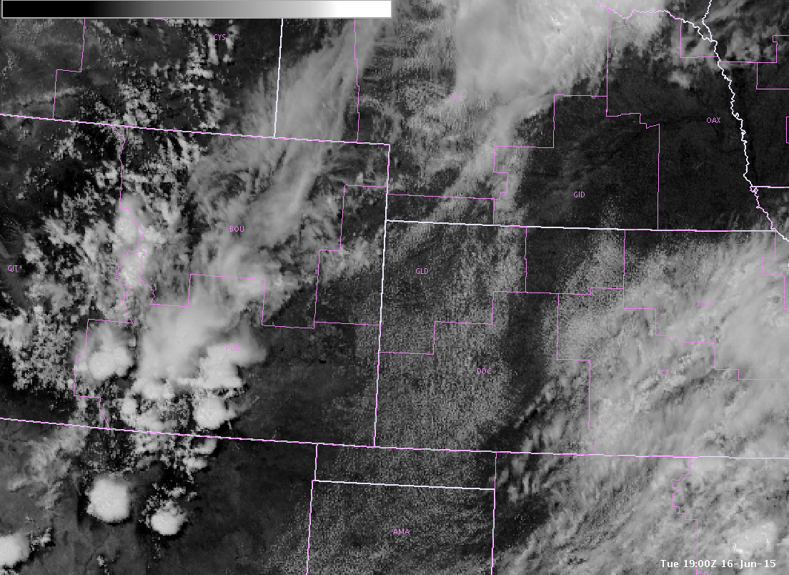
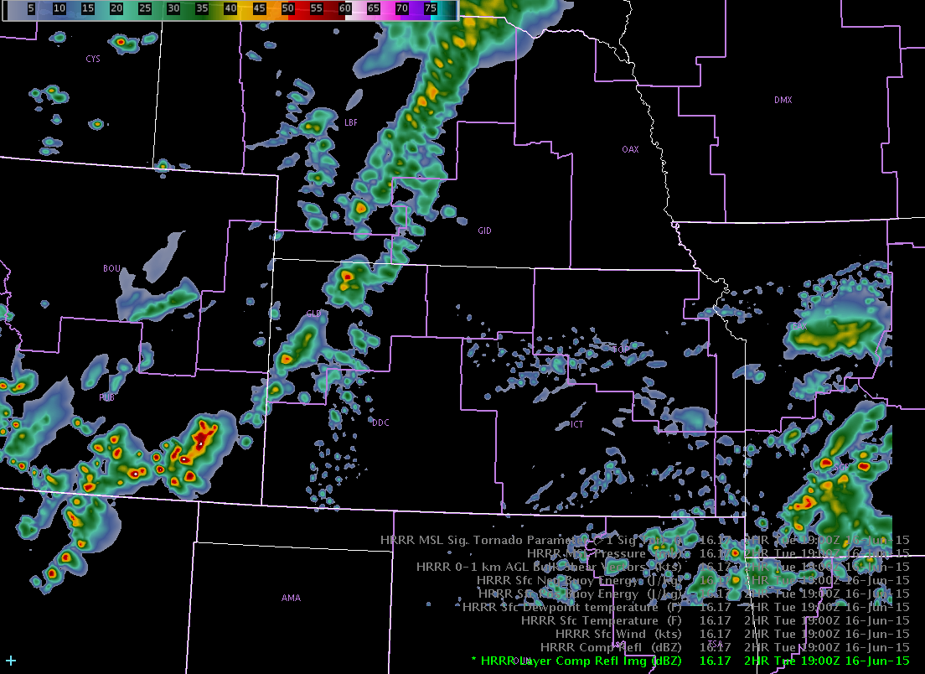
Why not use the NWP sounding?
Observed GOES Visible
HRRR 2-hr forecast
2 hr fcst
from 17Z run
1900 UTC June 16, 2015
Atmosphere with clear, blue sky
1900 UTC June 16, 2015
Atmosphere with deep convection
Subject to NWP issues/errors; soundings might be within model convection
Notes:
Why not use soundings from models? Here's a 2-h HRRR forecast over southeast Colorado. If you wanted to know about the thermodynamics present at that time, wouldn't it be better to NUCAPS observations that are independent of the model and its -- on this day -- timing problems?

Slide 12
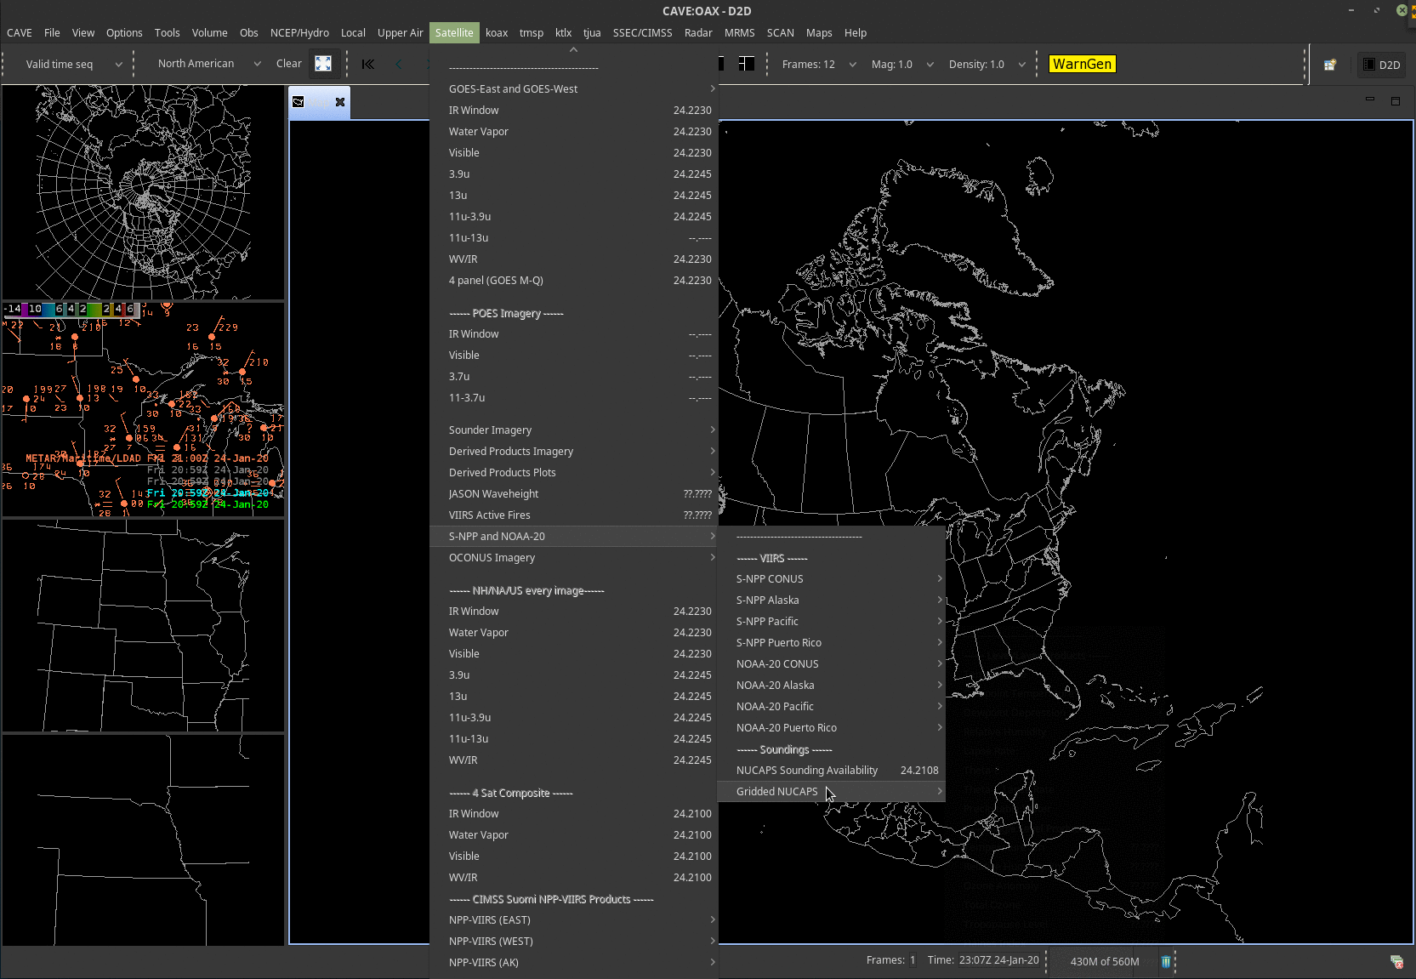
In the WFO AWIPS,
NUCAPS soundings are under
Satellite > S-NPP and NOAA-20 > NUCAPS Sounding Availability
(right above ‘GriddedNUCAPS’)
Notes:
NUCAPS soundings at that WFO are accessed under the Satellite Tab. As of early 2019, only Suomi NPP NUCAPS soundings are available at WFOs. NOAA-20 NUCAPS will flow later this year, perhaps as soon at April.

Slide 13
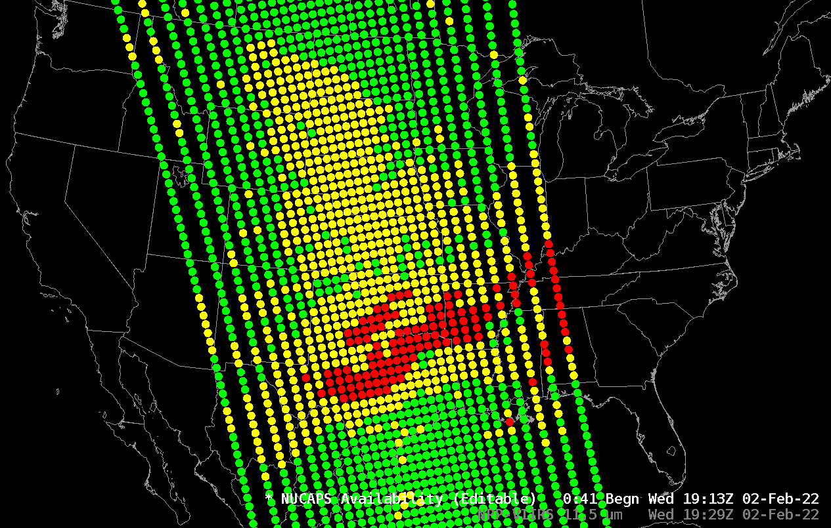
Green Dots: Retrievals Completed Successfully
Yellow Dots: IR Retrieval Failed
Red Dots: IR and Microwave Retrievals failed
The swath of points will typically show
up about 60-75 minutes after the pass
Notes:
Doing so will bring up the location of the latest NUCAPS sounding points, which are denoted by green circles. Soundings are available at each of these points. These soundings from 18:50 UTC likely were available starting around 2000 UTC.

Slide 14
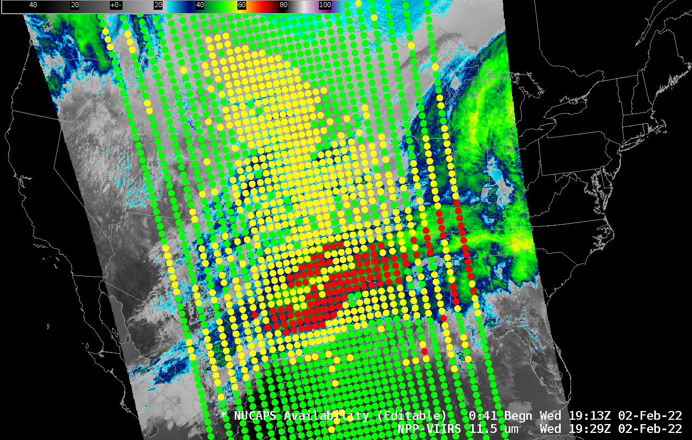
Plotting points on satellite imagery
helps you anticipate what you’ll see
Green: Mostly Clear Skies
Yellow: Mostly Cloudy Skies
Red: Precipitation more likely
Notes:
Plotting points on a satellite image (this is VIIRS 11.45 micrometer visible imagery) is a worthwhile task – it helps a forecaster anticipate what the soundings will show

Slide 15
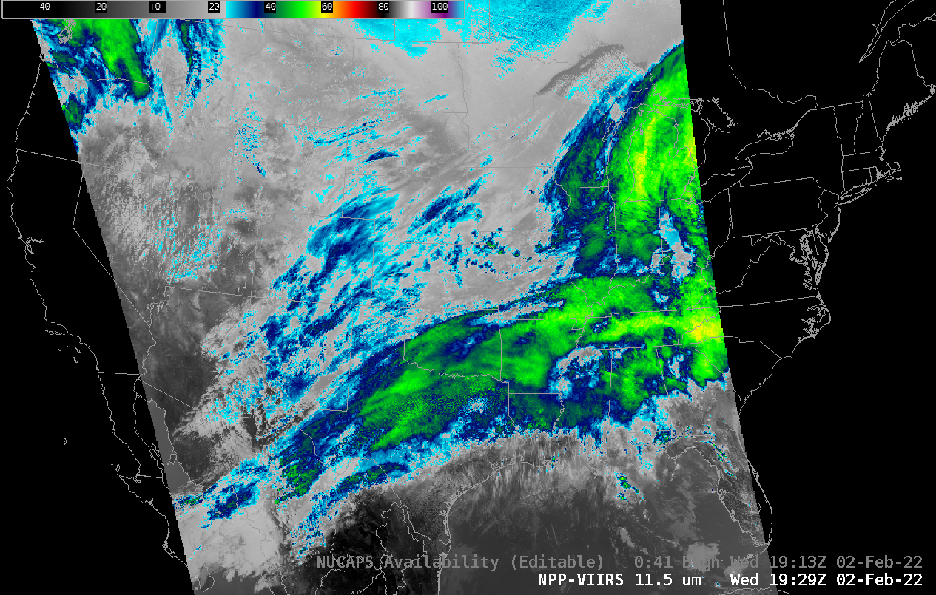

Slide 16
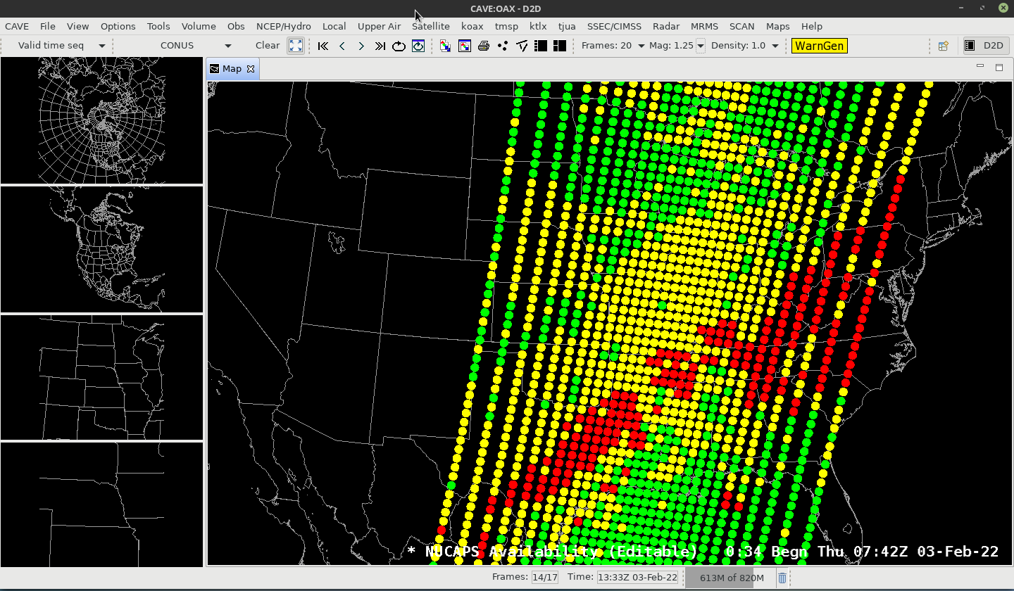
There is a lot of data to process through! It can be tedious to click on each dot and view the soundings that way

Slide 17
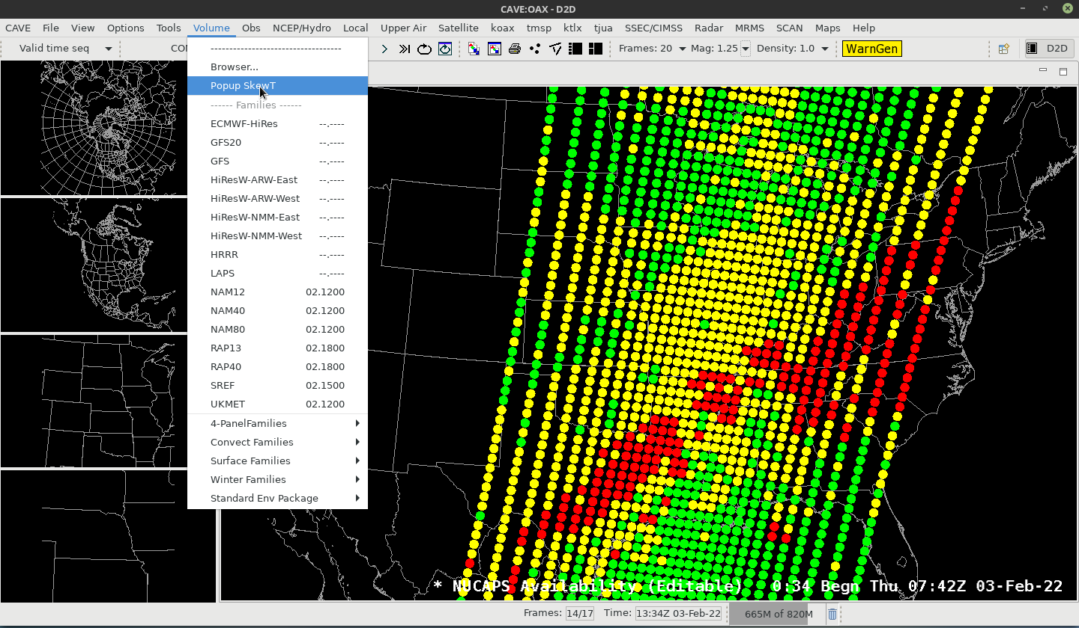
Solution: Use Popup SkewTs; they are available under the ‘Volume’ tab

Slide 18
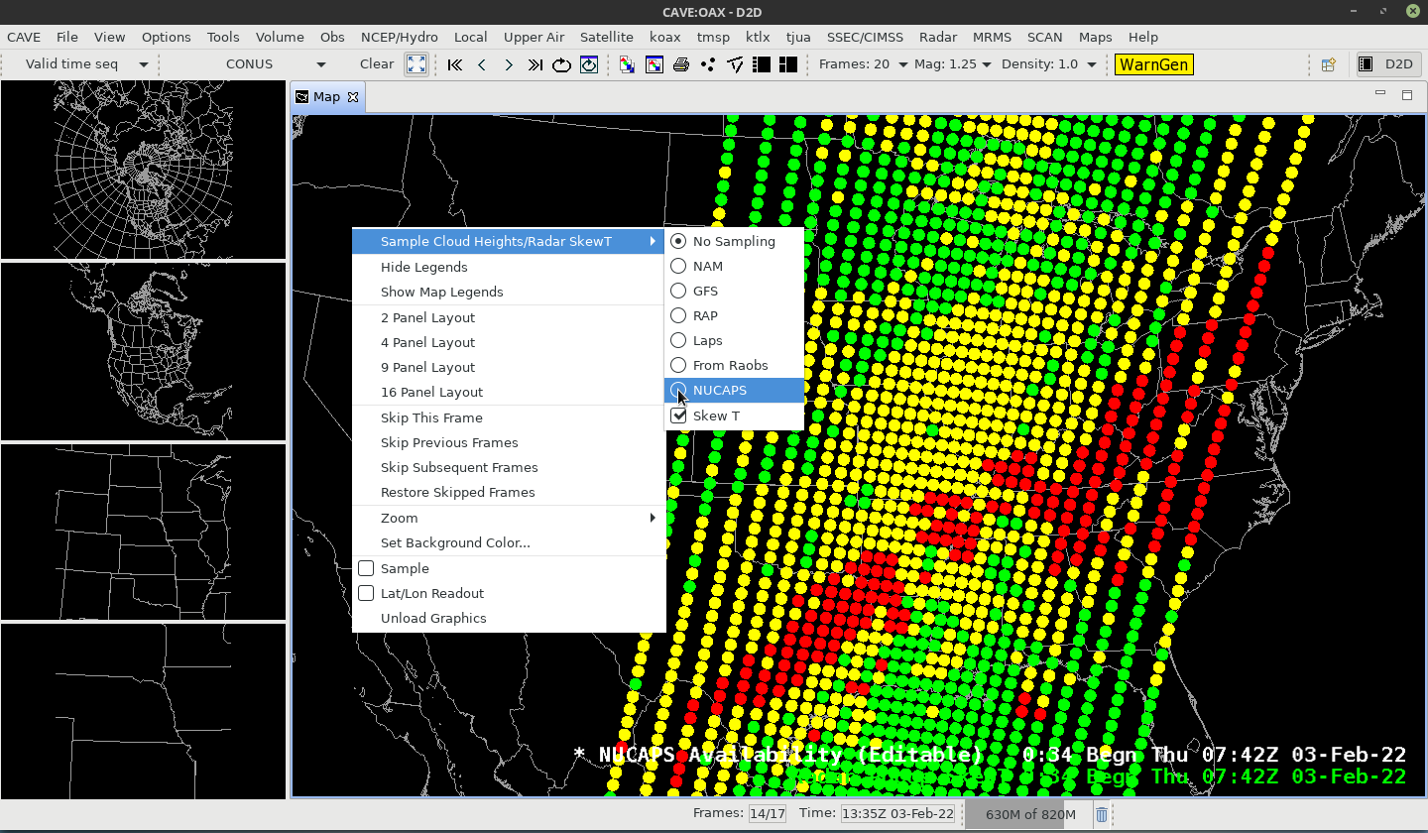
After clicking on Popup SkewTs under the ‘Volume’ tab, right-click in the window to bring up the ‘Sample’ menu – and choose ‘NUCAPS’

Slide 19
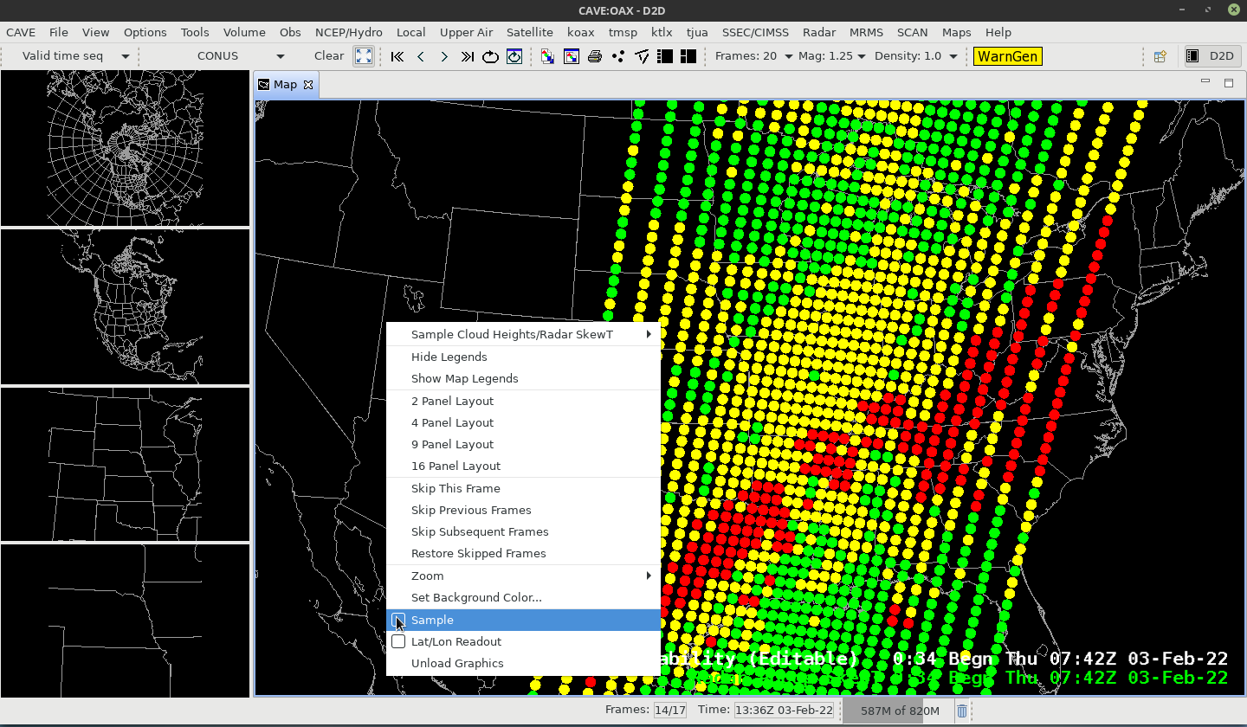
Also: toggle ‘Sample’ to on

Slide 20
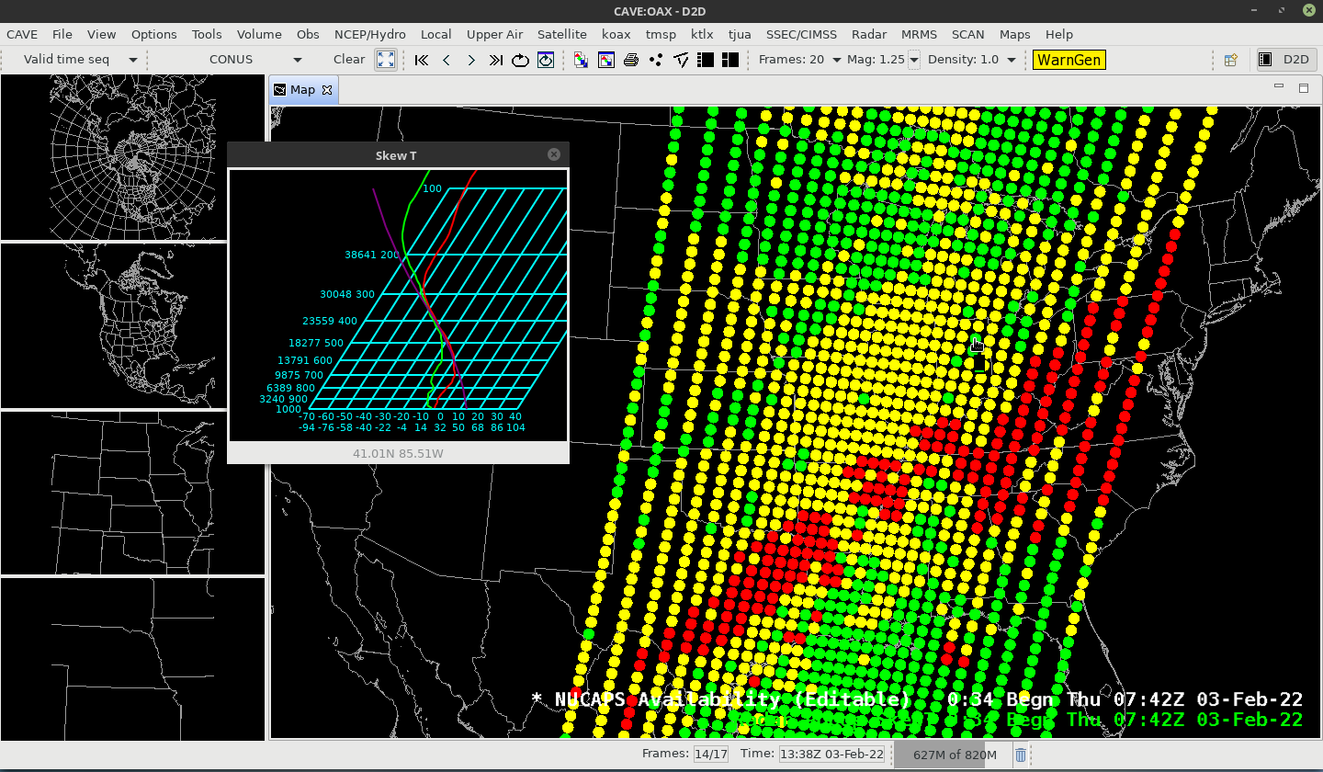
Then mouse over the Sounding Availability points and see the data
Useful for finding thresholds, where gradients might start, etc.

Slide 21
Then mouse over the Sounding Availability points and see the data
Useful for finding thresholds, where gradients might start, etc.

Slide 22
Then mouse over the Sounding Availability points and see the data
Useful for finding thresholds, where gradients might start, etc.

Slide 23
Then mouse over the Sounding Availability points and see the data
Useful for finding thresholds, where gradients might start, etc.

Slide 24
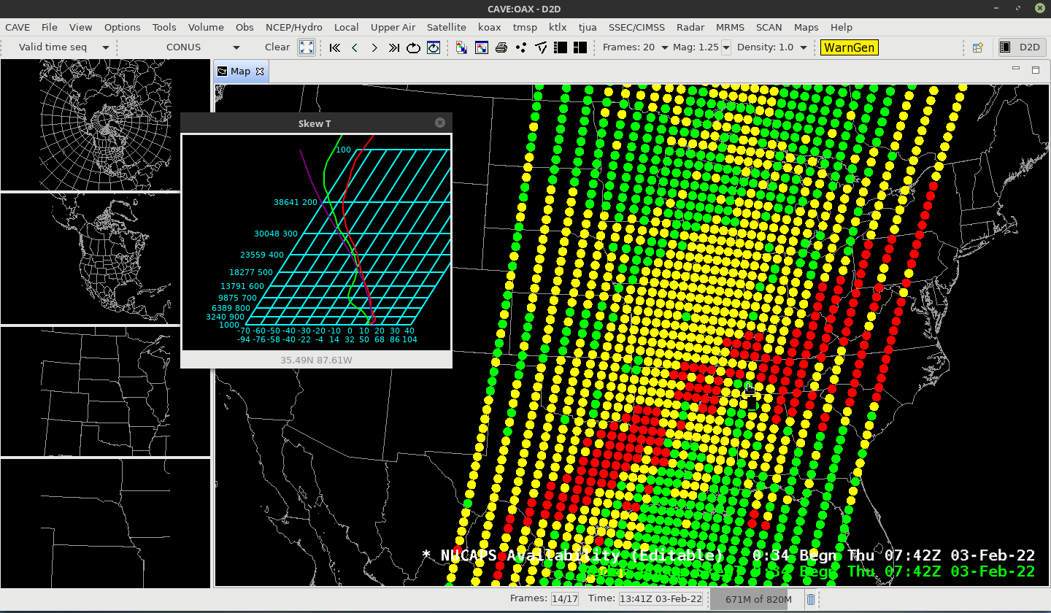
Then mouse over the Sounding Availability points and see the data
Useful for finding thresholds, where gradients might start, etc.

Slide 25
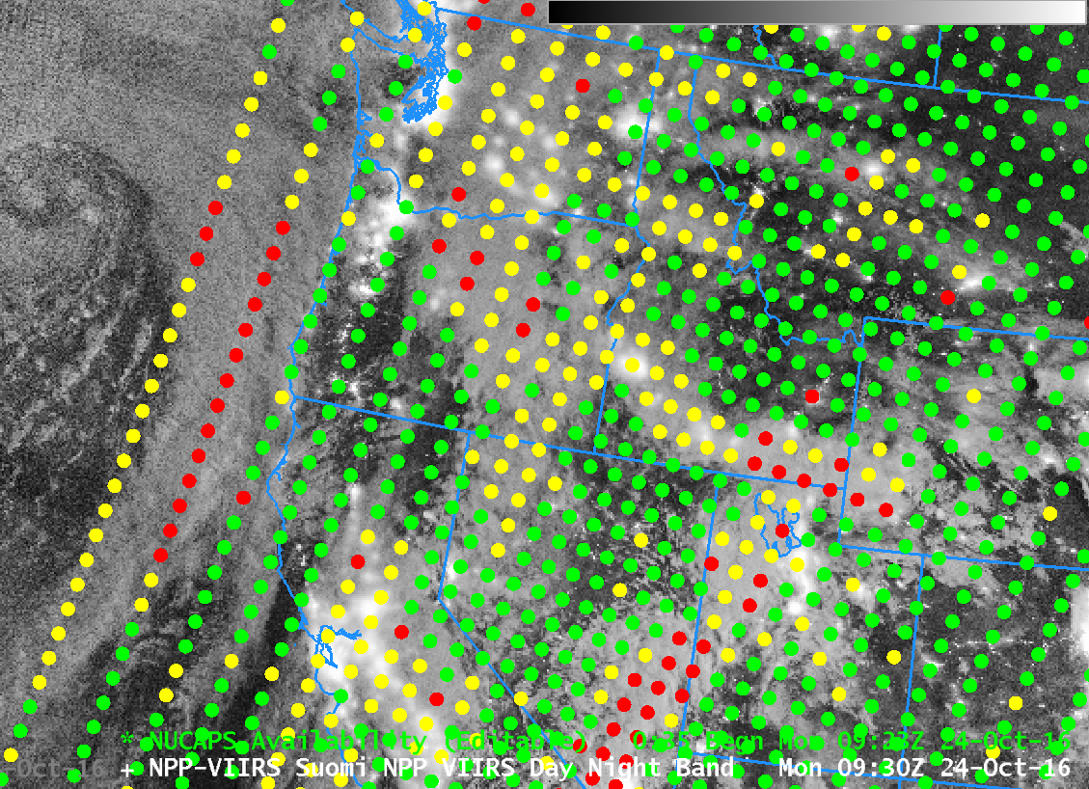
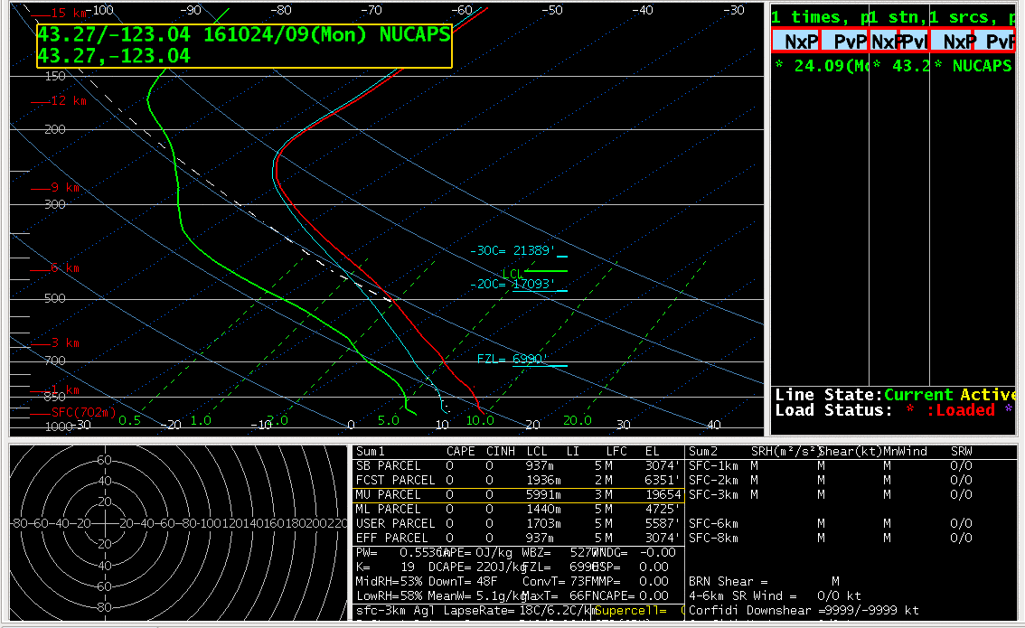
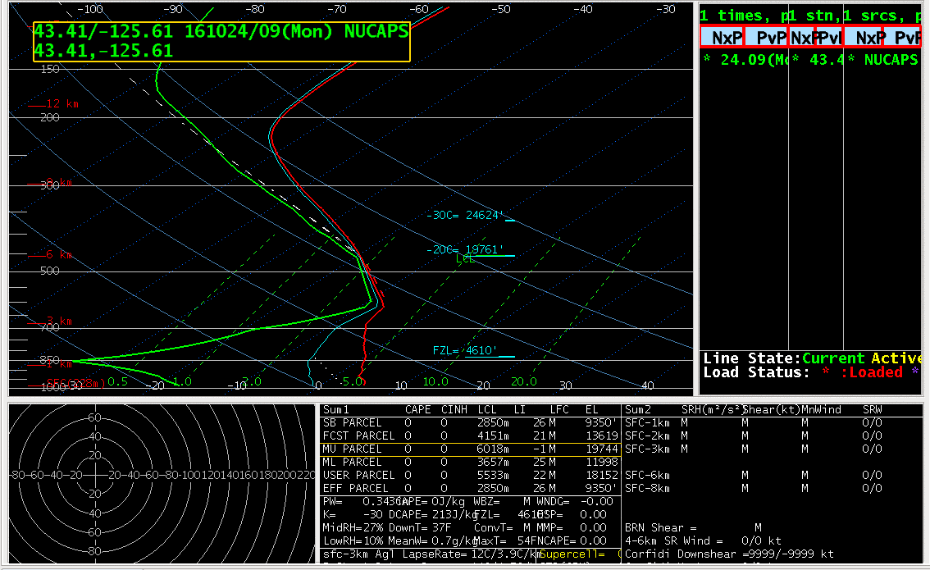
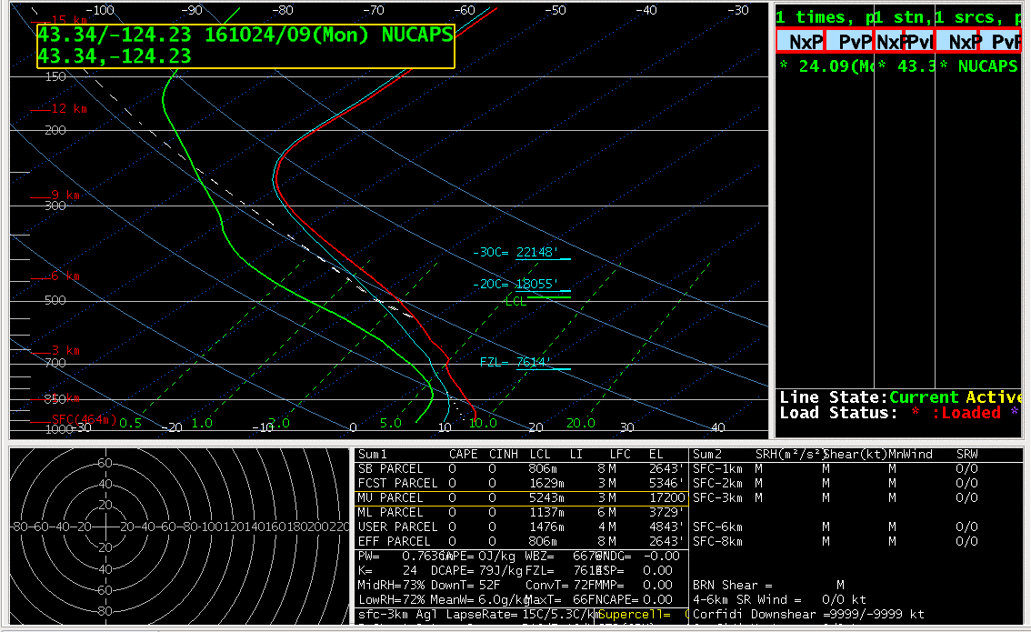
NUCAPS Sounding Points overlain over a Visible Suomi NPP Image
3 Points to examine: Clear Air, Near a cloud edge, in deep clouds
Clear Air
Near Clouds
Deep Clouds
Notes:
One in deep clouds over Kentucky

Slide 26
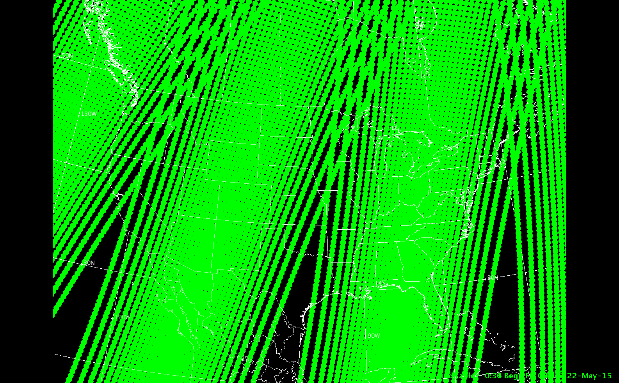
4 consecutive passes over CONUS; note the overlap north of ~40N,
Slight gaps south of ~35N where you’ll have no data
The path locations shift eastward (about 1/3rd pathwidth) from one day to the next
Notes:
This shows 4 consecutive passes. North of 40 N there's overlap from one pass to the next. But there are regions over the southern US -- small regions -- that are unsampled. Of course, these regions differ from day to day as the orbits shift eastward from one day to the next.

Slide 27
What do Consecutive Soundings Get you?
Western-most scan at ~1700 UTC
Eastern-most scan at ~1830 UTC
NOAA-20 can give you two samplings of a destabilizing atmosphere 90 minutes apart!

Slide 28
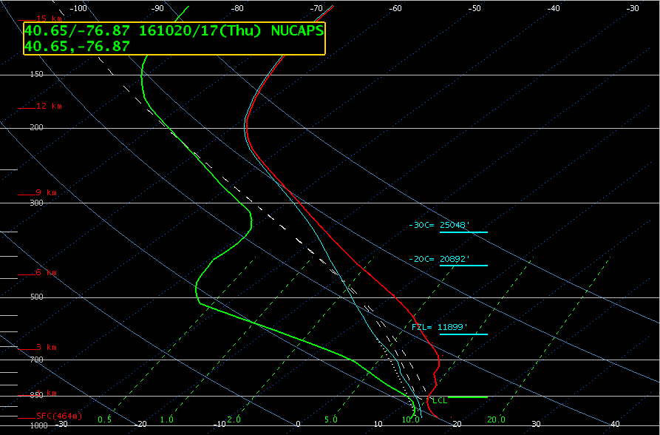
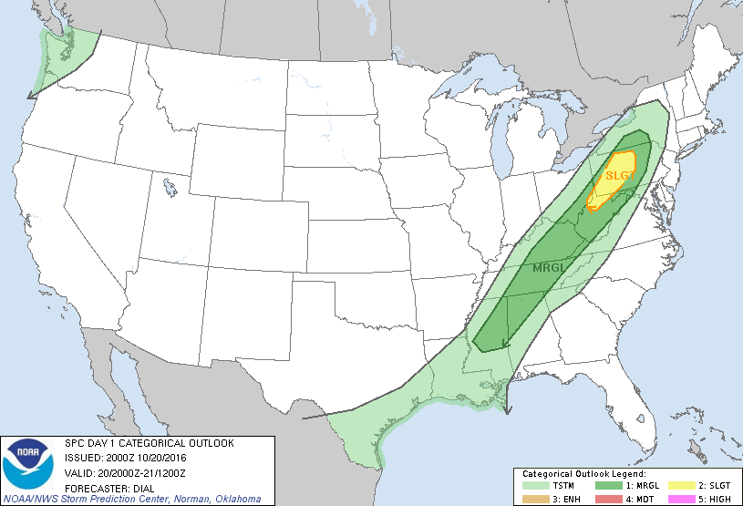
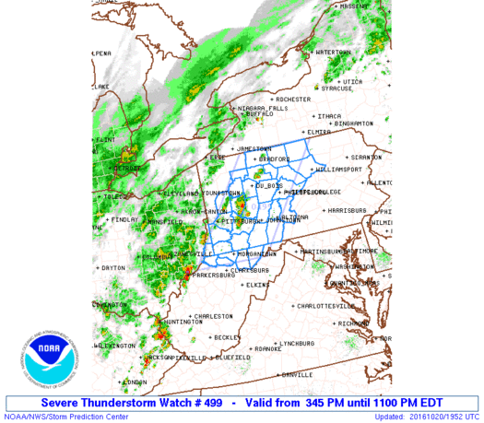
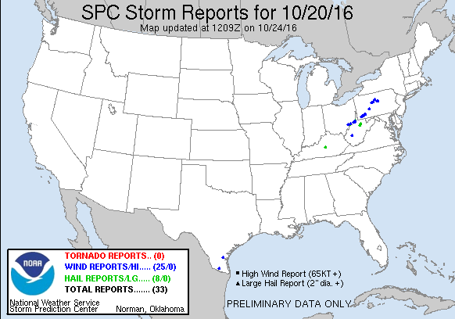
1700 UTC

Slide 29
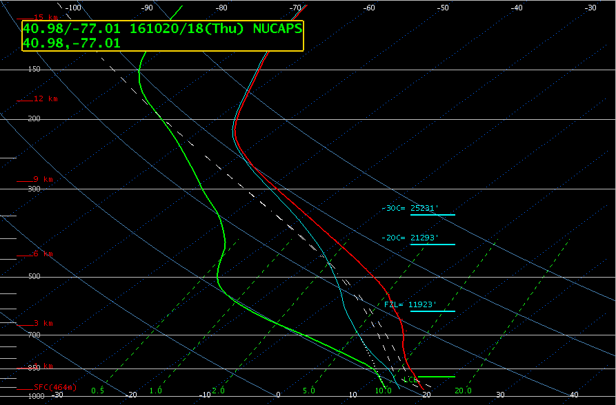
1830 UTC

Slide 30
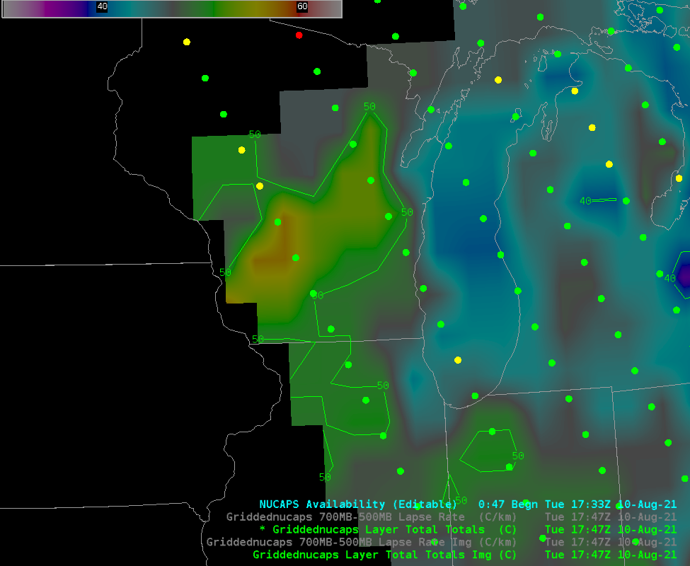
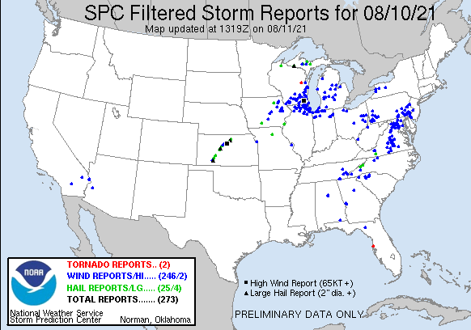
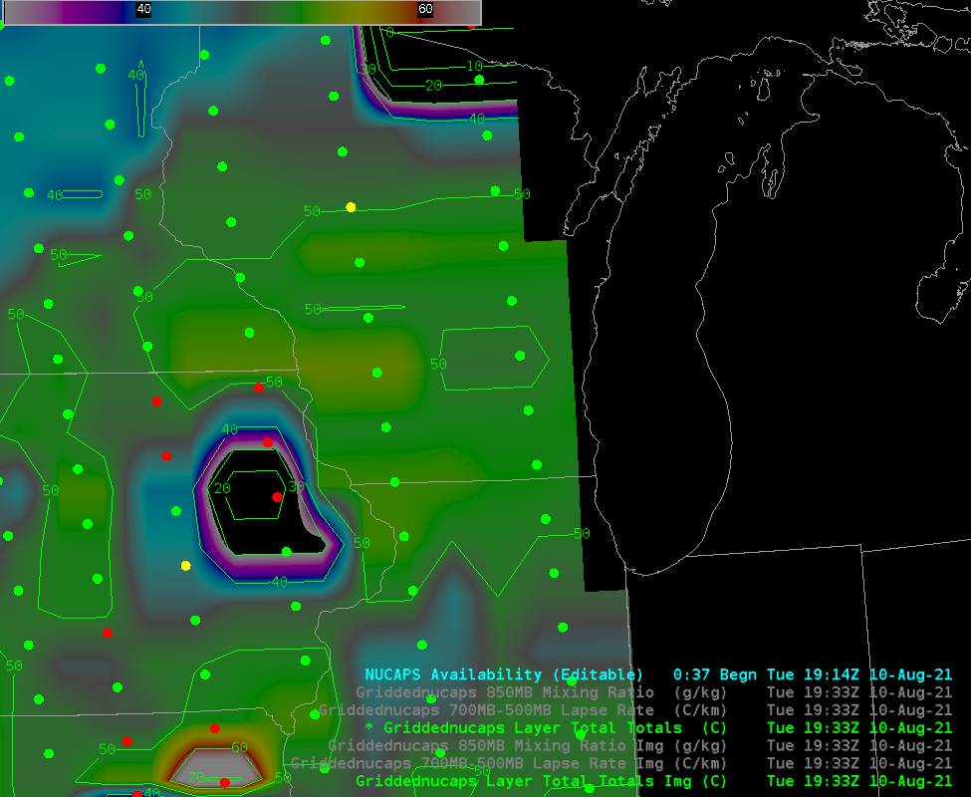
Case #2
1747 UTC
Note: This slide includes Gridded NUCAPS fields
Thermodynamic profiles are interpolated in the horizontal and displayed
This is a much more efficient way of quickly viewing all the thermodynamic information in a swath of NUCAPS profile!
These are accessible right under ‘NUCAPS Sounding Availability’
1932 UTC

Slide 31
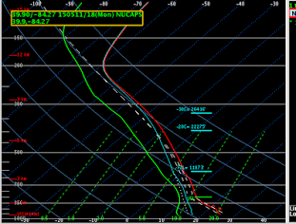
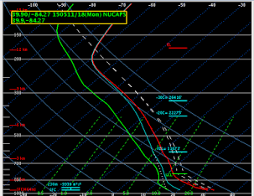
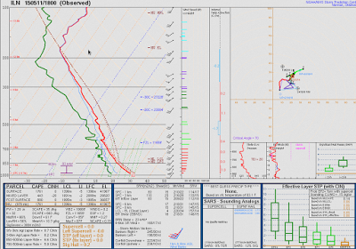
Blog Post: “Observed Radiosonde Data/NUCAPS Comparison” May 11 - Wilmington, OH http://goesrhwt.blogspot.com/2015/05/observed-radiosonde-datanucaps.html
“However, if the boundary layer temperature and dew point profile is modified using nearby METAR observations (85/61), the SBCAPE is more representative to the observed sounding (1761 vs. 1688 J/kg):”
Unmodified NUCAPS
Modified NUCAPS
Special Sounding at 18z
Sfc: 77/55
Sfc: 85/61
“You can't just modify the surface values, you must modify the whole mixed layer, otherwise you get unrealistic lapse rates”
Notes:
If you edit the lower part of the sounding (the part that is observed with the least amount of accuracy from a satellite) to match nearby METARs – by altering the temperature and dewpoint (details on how to do that will be shown shortly), you'll get a better representation of the thermodynamic profile.
In this case, a special 18z sounding is used to compare to modified vs. unmodified NUCAPS soundings. The sounding modified to reflect surface METARs agreed with the special sounding.

Slide 32
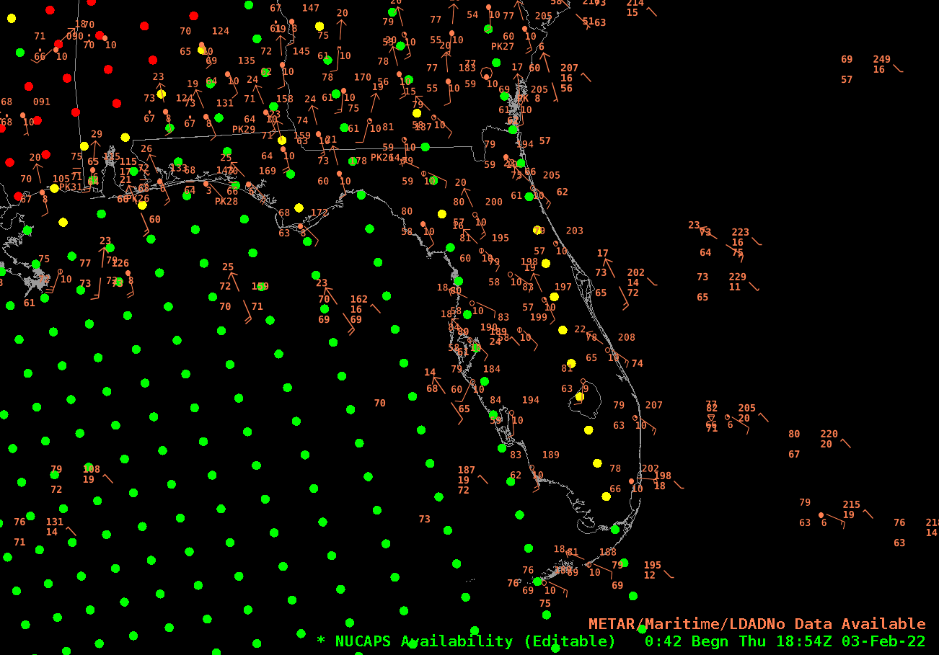
Editing
Sometimes the lower part of the sounding does not quite match nearby observations. You can modify NUCAPS Soundings in AWIPS. Consider the profile on the west coast of FL, where T/Td are ~81 / 60
Notes:
There is a graphical editor in AWIPS that allows you to grab the sounding and move it – either the temperature or dewpoint lines. It’s common enough to see surface values from METARs that do not match values in nearby NUCAPS soundings. Work is ongoing to make this change automatic and it may be available by HWT in 2017.

Slide 33
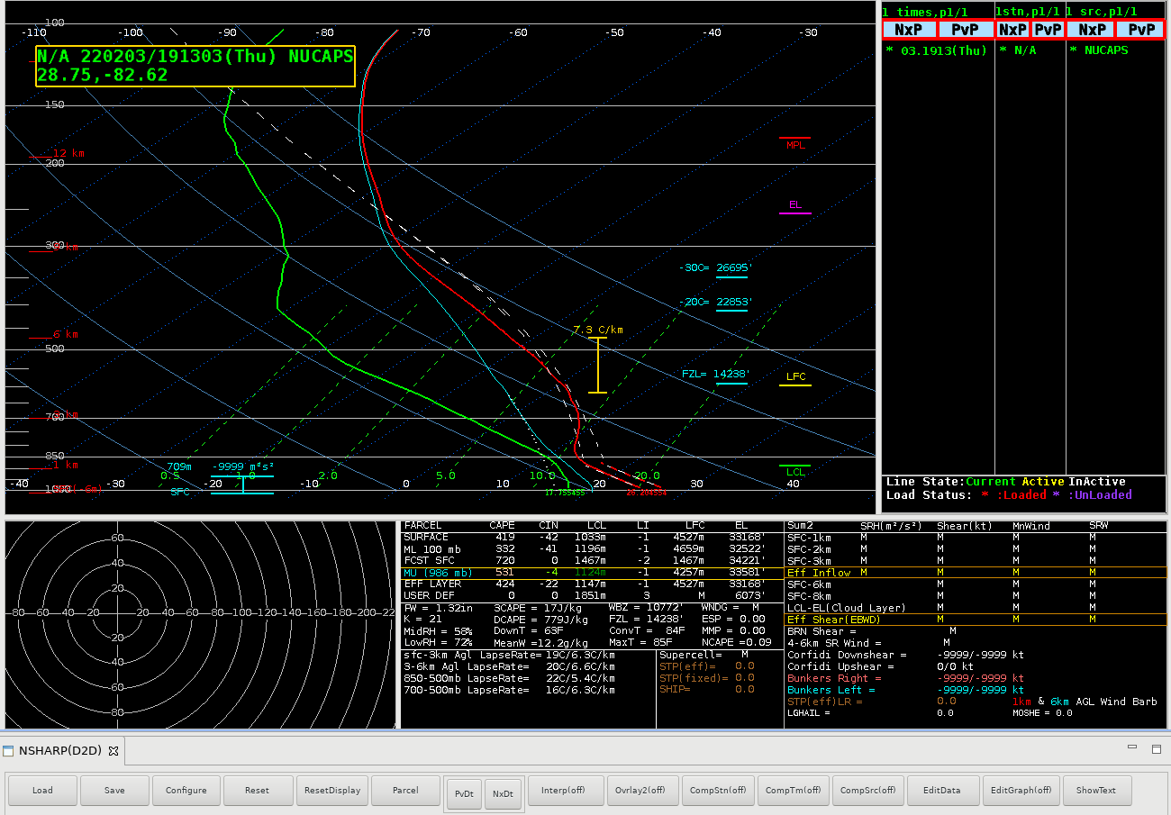
Do the surface values match observations in the METAR plot?
No? Change them. Toggle ‘Edit Graph’ to ‘On’
Notes:
In the meantime, however: Here's the sounding near Philadelphia from the previous slide. The T/Td do not match METAR observaions. To edit, toggle 'Edit Graph' to 'On'

Slide 34
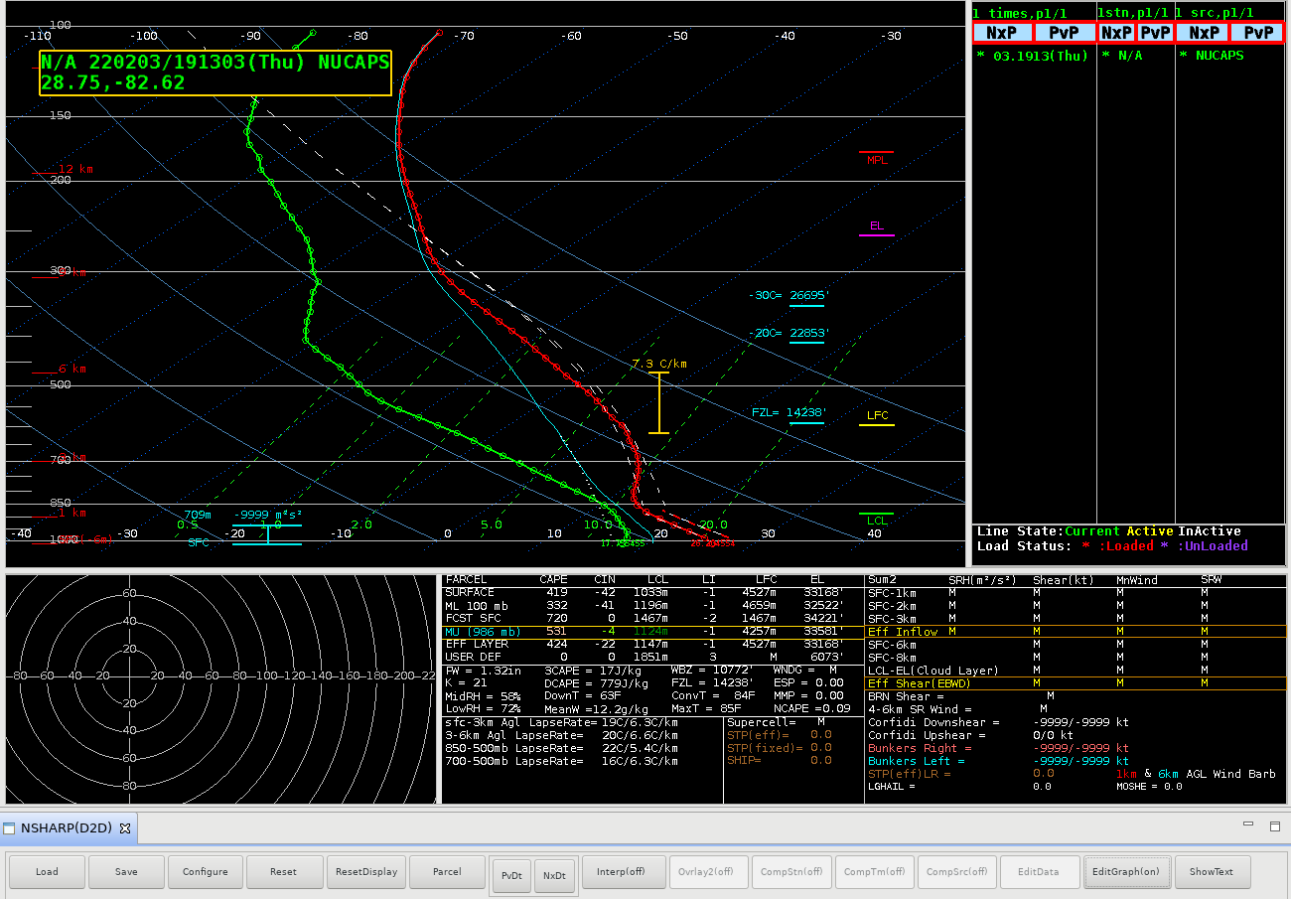
Draggable Points appear on the Temperature and Dewpoint lines.
Move the points to values that are more appropriate (then toggle ‘EditGraph’ to off)
Notes:
Move the draggable points around to create a sounding that matches surface observations. Caution: there is no ‘undo’ button!

Slide 35
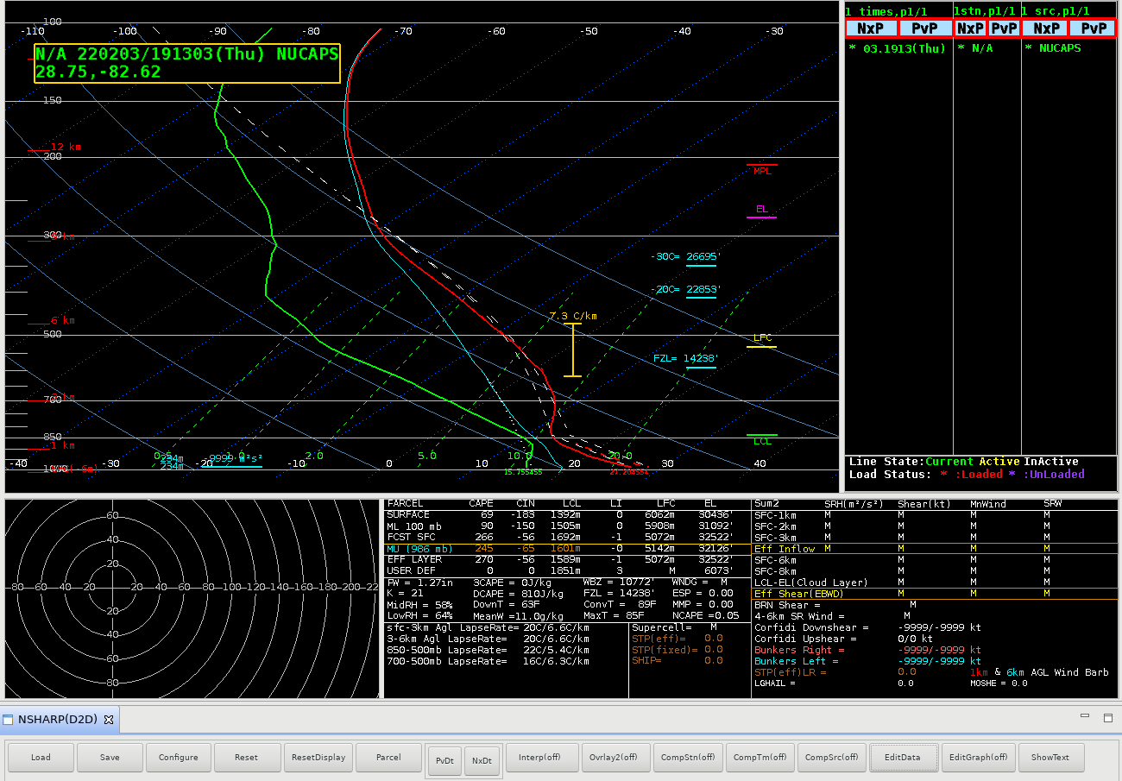
Don’t like things you’ve changed? Click ‘Reset’ and start over.
Note that derived parameters – in the red box – have also changed
Notes:
In this case, the temperature near the surface has been increased to make it more closely match METARs. This in turn changes the LCL, or the EL. No change has been made to the dewpoint line, but that could be done too. If you think an inversion is too weak, change it.

Slide 36
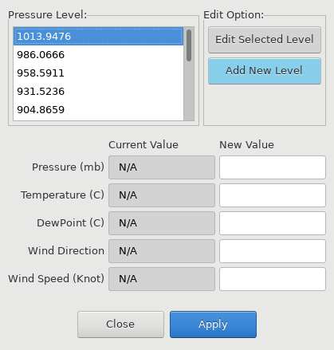
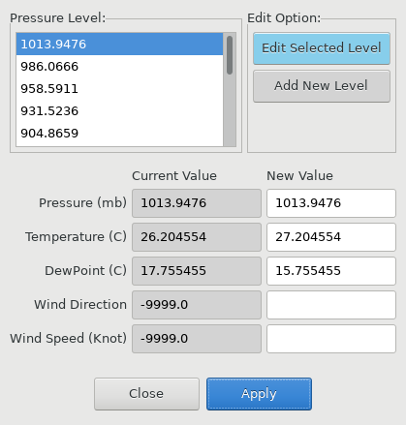
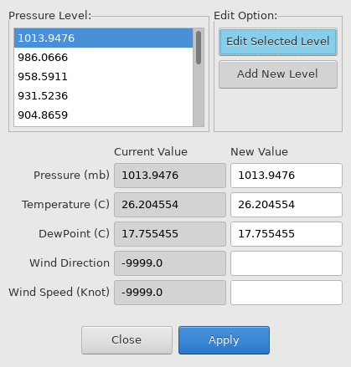
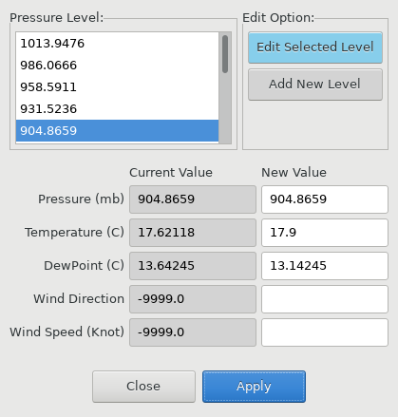
You can also click on the ‘EditData’ box, which brings up text boxes that you can change
1
3
Changed
Values
2
Original
Values
4

Slide 37
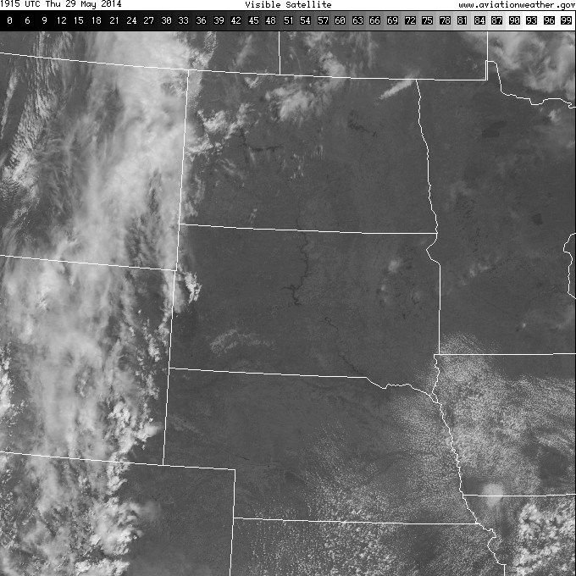
Forecast Problem: 29 May 2014 Afternoon/Evening Convection ?
GFS 9 hour fcst
From 12UTC 29 May
Valid 21 UTC 29 May
1915 UTC
Visible
Will the Cumulus Field develop further? (As suggested by the GFS)
Notes:
This is a more forecast-specific use of the soundings. Will that broken cumulus field on the border of Iowa/Nebraska develop? The GFS is predicting QPF later in the day.

Slide 38
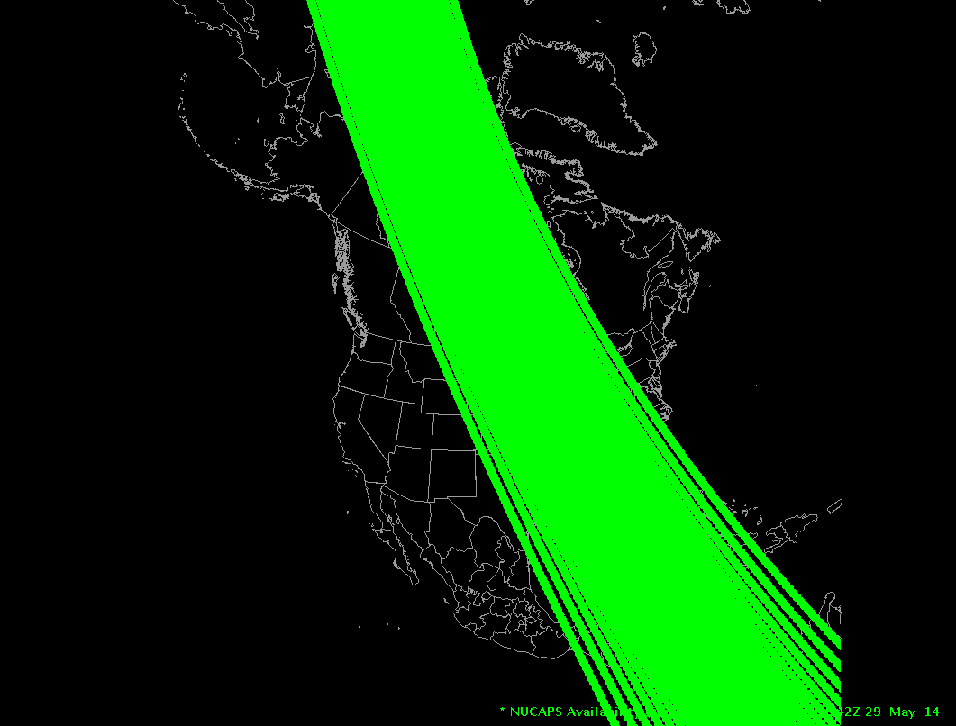
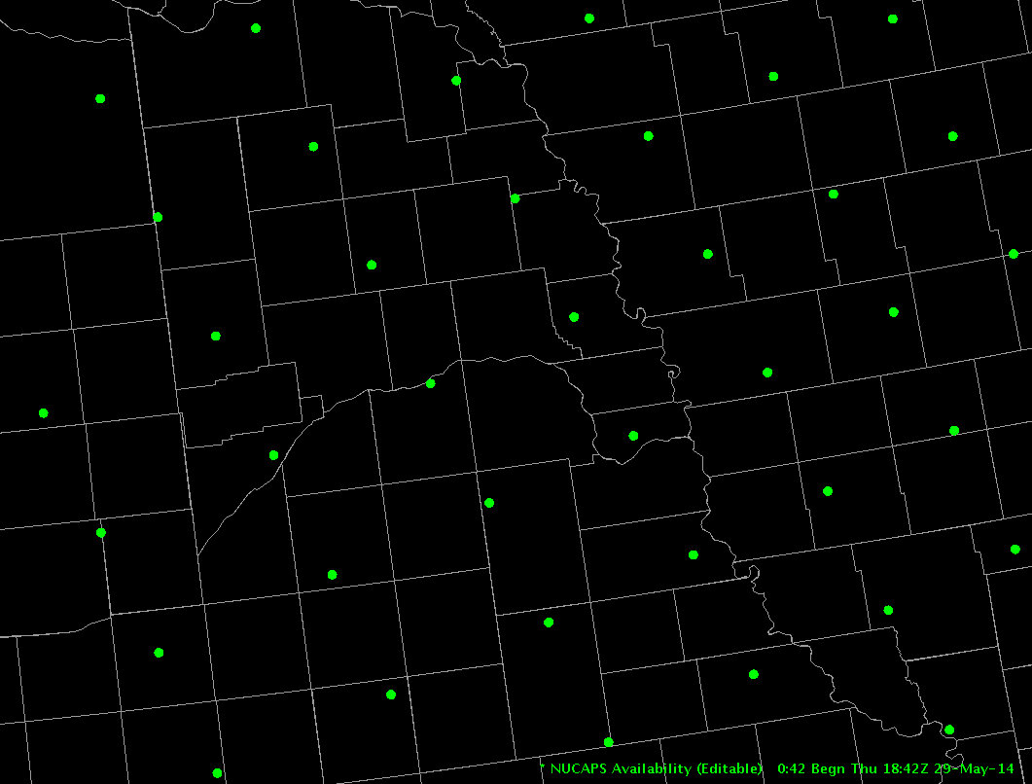
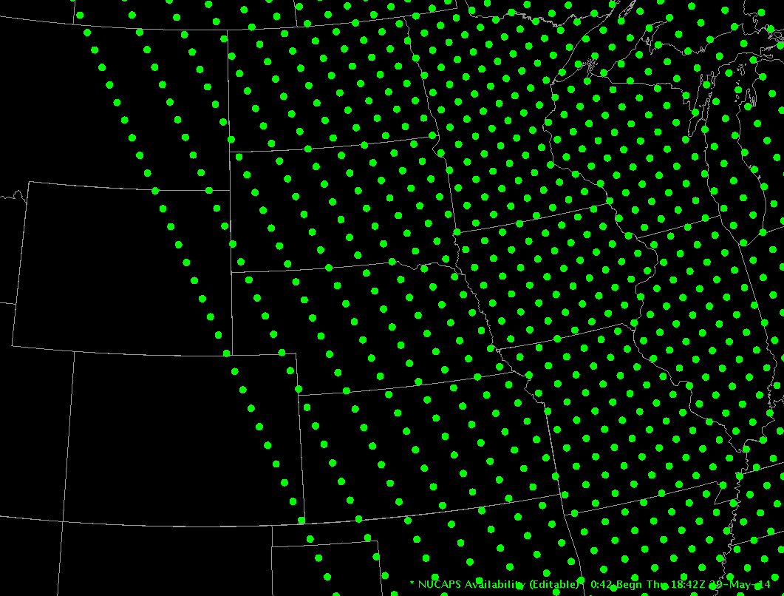
NUCAPS Soundings give thermodynamic information at a convenient time!
1842 UTC NPP pass
Notes:
Suomi NPP overflies the central US around 18 or 19z; this provides timely information on the state of the atmosphere in early afternoon. Here we have three different scenes, zooming in from North America to the Plains to WFO Omaha.
Let's look at the sounding in eastern Nebraska, circled in red.

Slide 39
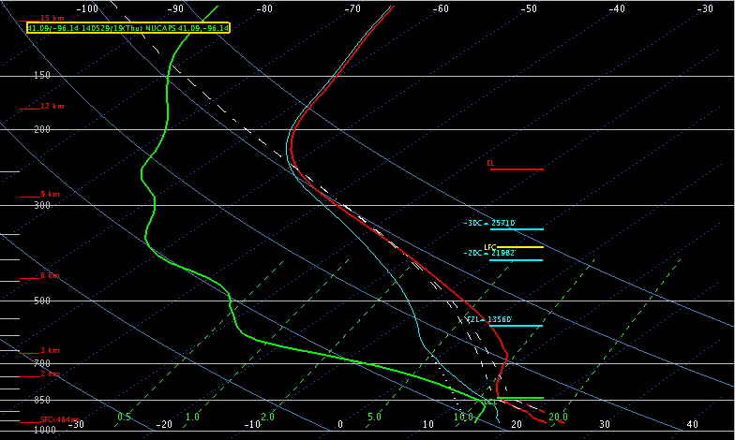
NUCAPS Sounding 1842 UTC 29 May 2014 Would you expect convective development?
T = 79F (METAR = 80F)
Td = 60F (METAR = 63F)
CAPE ~ 50 J/KG
Notes:
This sounding has a surface temperature and dewpoint close to observations (so we needn't edit the sounding to bring it into accord with observations). CAPE is small. Would you expect convective development?

Slide 40
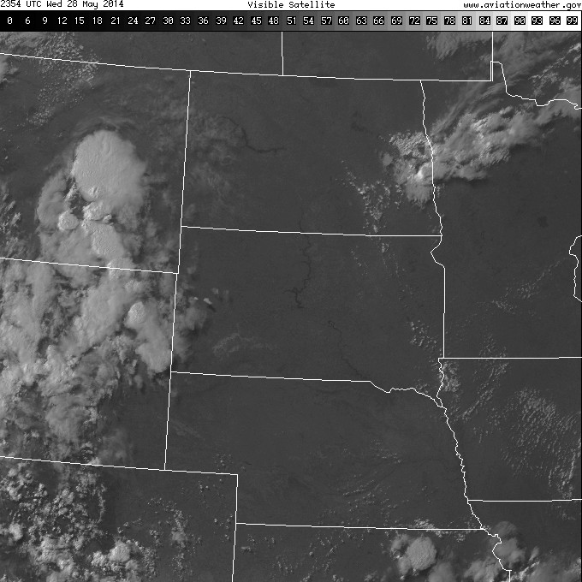
2354 UTC
Visible
Notes:
Late afternoon visible imagery shows that the cumulus field has dissipated.

Slide 41
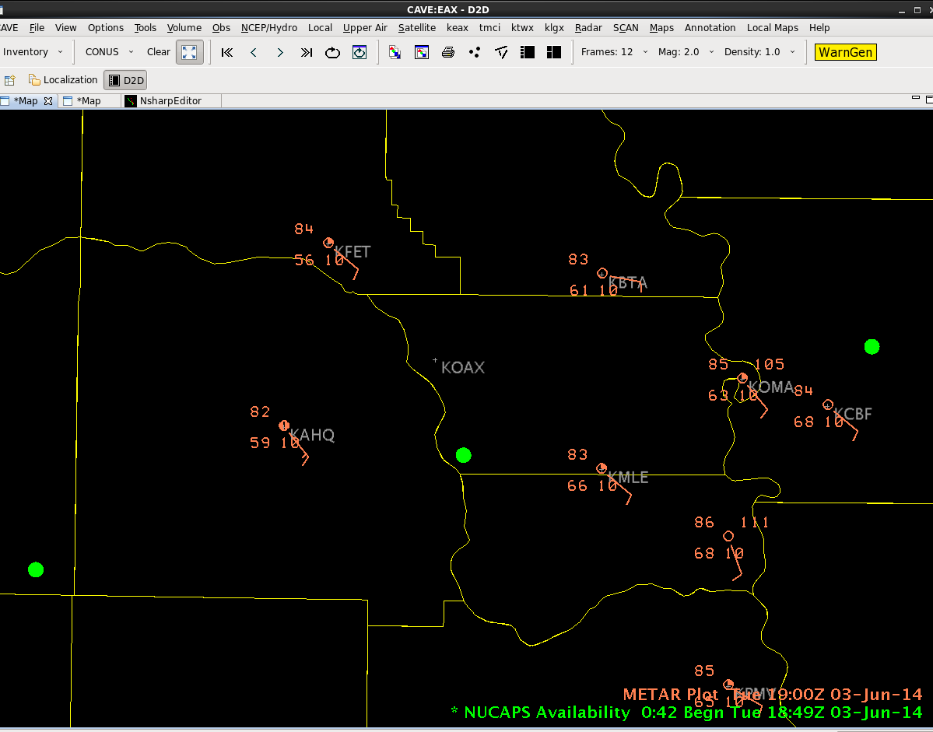
June 3, 2014 High Risk Severe Weather Event in Omaha
Notes:
A couple days later, Omaha experienced severe weather. This image shows the storm reports, damage, and two NUCAPS sounding sites from 1849 UTC on 3 June. Note also the gradient in dewpoint in the plotted METARs.
The next page shows the NUCAPS sounding for the site just south of the Omaha WFO -- the one in the Green Box.

Slide 42
June 3, 2014 High Risk Severe Weather Event in Omaha
NUCAPS ~10 KM south of OAX
1849Z June 3, 2014 – cloudy
scene, but still gives info!
Modified for surface METAR
Ob of T=83, Td=63
SB CAPE = 1851
Notes:
The NUCAPS sounding from the site in the green box on the previous page -- a cloudy region (but not dense clouds), but the sounding still gives information because not all of the CrIS points were in overcast regions. This sounding has been modified so the surface METARs match the sounding values. Surface-based CAPE is 1851.

Slide 43
June 3, 2014 High Risk Severe Weather Event in Omaha
NUCAPS sounding locations
overlain on VIIRS 0.64
1905Z June 3, 2014
Notes:
The boxed site is the one we just looked at. Imagine 9 points centered on this boxed green point – some of those points are in relatively clear skies. Note that an even-more clear Sounding is just south -- and recall that there is a strong dewpoint gradient in the region.

Slide 44
June 3, 2014 High Risk Severe Weather Event in Omaha
NUCAPS sounding locations
Overlaid with VIIRS 0.64
1905Z June 3, 2014
Location of OAX in yellow
Northern dot is within a few
KM of KOAX, but under
cloud cover
Southern dot is in a nearly
Cloud-free location, and is
warmer and more humid
OAX
Notes:
Zooming in again, we see the sounding from the cloudy region -- boxed in green, and also a second sounding to the south where skies are clearer. (And dewpoints are warmer there too)

Slide 45
June 3, 2014 High Risk Severe Weather Event in Omaha
NUCAPS sounding
40 km south of OAX
1849Z June 3, 2014
Unmodified
SB CAPE = 686
Notes:
Here is the unmodified NUCAPS sounding at that southern site. Surface-based CAPE is around 700 -- but the surface temperature/dewpoint in the sounding do not match the METARs. This is a good sounding to edit.

Slide 46
June 3, 2014 High Risk Severe Weather Event in Omaha
NUCAPS sounding
40 km south of OAX
1849Z June 3, 2014
Modified for surface METAR
Ob of T=85, Td=68
SB CAPE = 3095
Notes:
Once the sounding is edited so that its lowest temperature/dewpoint match the METAR, surface based CAPE exceeds 3000! This kind of information should influence your interpretation of present conditions.

Slide 47
Will convection develop?
17 August 2019 – sequential overlapping passes over the upper Midwest
Compare the stability at the northern vs. southern edges of the line

Slide 48
Summary
Produced with every Polar Orbiter pass, time latency is about 60 minutes but better if you have Direct Broadcast
Data comes from NOAA-20, Suomi NPP and also from Metop A/Metop B. Only NOAA-20 passes are in AWIPS now
Tropospheric resolution: At most 10 temperature layers and about five moisture layers
Familiarize yourself with what information the soundings can yield
Learn how to modify the soundings if the lowest layers don’t agree with nearby METARs
A mix of infrared and microwave information. Regression can fail, but a sounding will still be produced. Status flag tells you the status of the Retrievals: Did they work?
NUCAPS tells you much about the state of the atmosphere’s thermodynamics, especially gradients, and how things are changing.
Notes:
A summary of this training is on this slide. Remember: NUCAPS gives a timely update to 1200 UTC soundings; use them to diagnose how the atmosphere has changed. You may have to modify the sounding to reflect surface conditions. Statistically, the best information from the NUCAPS sounding is moisture information in the mid-troposphere. This concludes the training on NUCAPS sounding data in AWIPS 2.

Slide 49
NUCAPS data are in AWIPS, and on-line
Gridded NUCAPS fields available from SPoRT
https://weather.msfc.nasa.gov/cgi-bin/sportPublishData.pl?dataset=griddednucaps
Gridded NUCAPS in RealEarth
https://nucaps.ssec.wisc.edu
NUCAPS profiles at NESDIS/STAR/OSPO
https://www.ospo.noaa.gov/Products/atmosphere/soundings/nucaps/pskewt/WORLD.html
Use these products to give you a better idea of what the atmospheric state is now, in regions with little data, or how it is evolving, in regions where (upper-air)data is taken “just” twice daily
Questions: scott.lindstrom@noaa.gov / scott.lindstrom@ssec.wisc.edu

